Slide 1
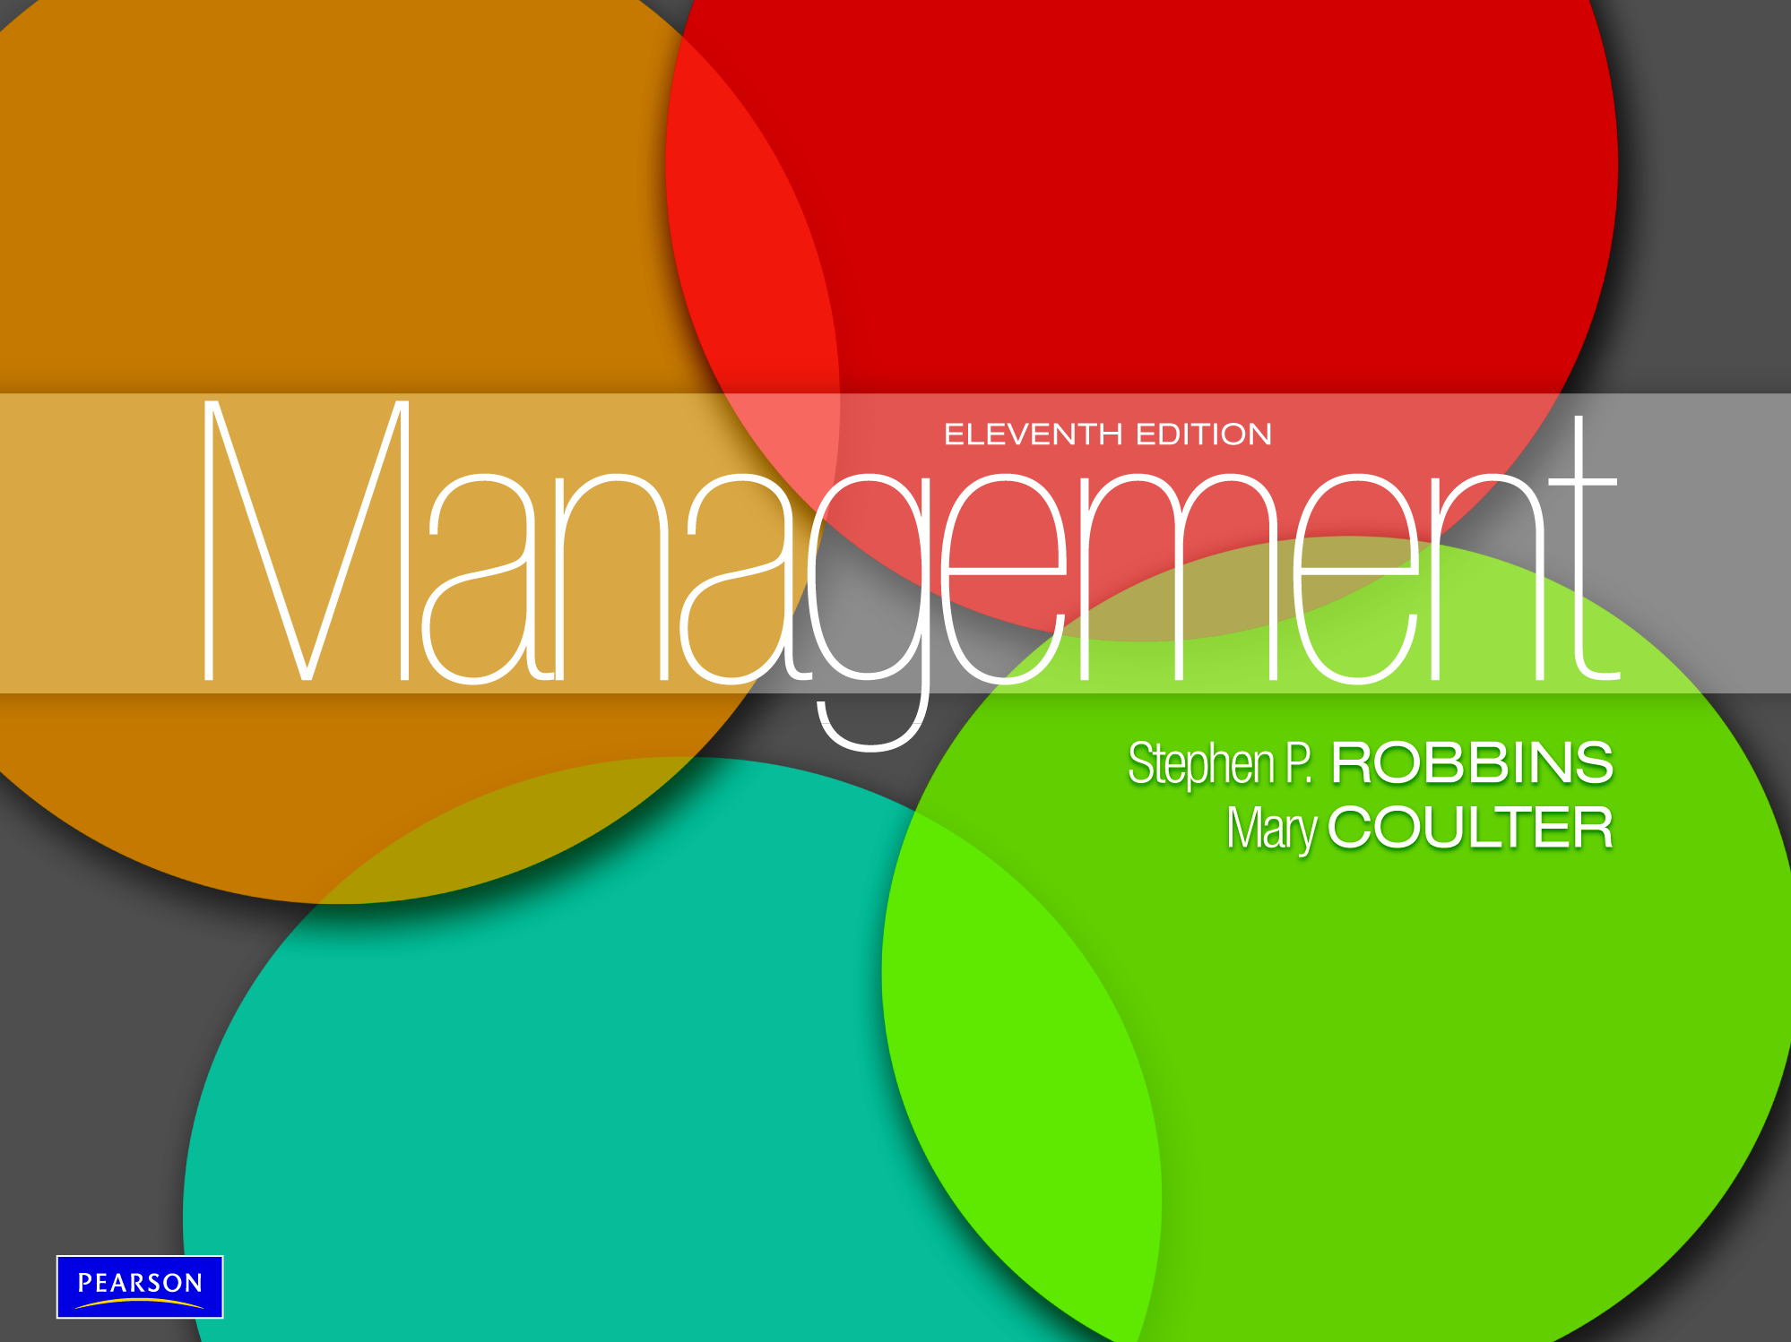

Slide 2
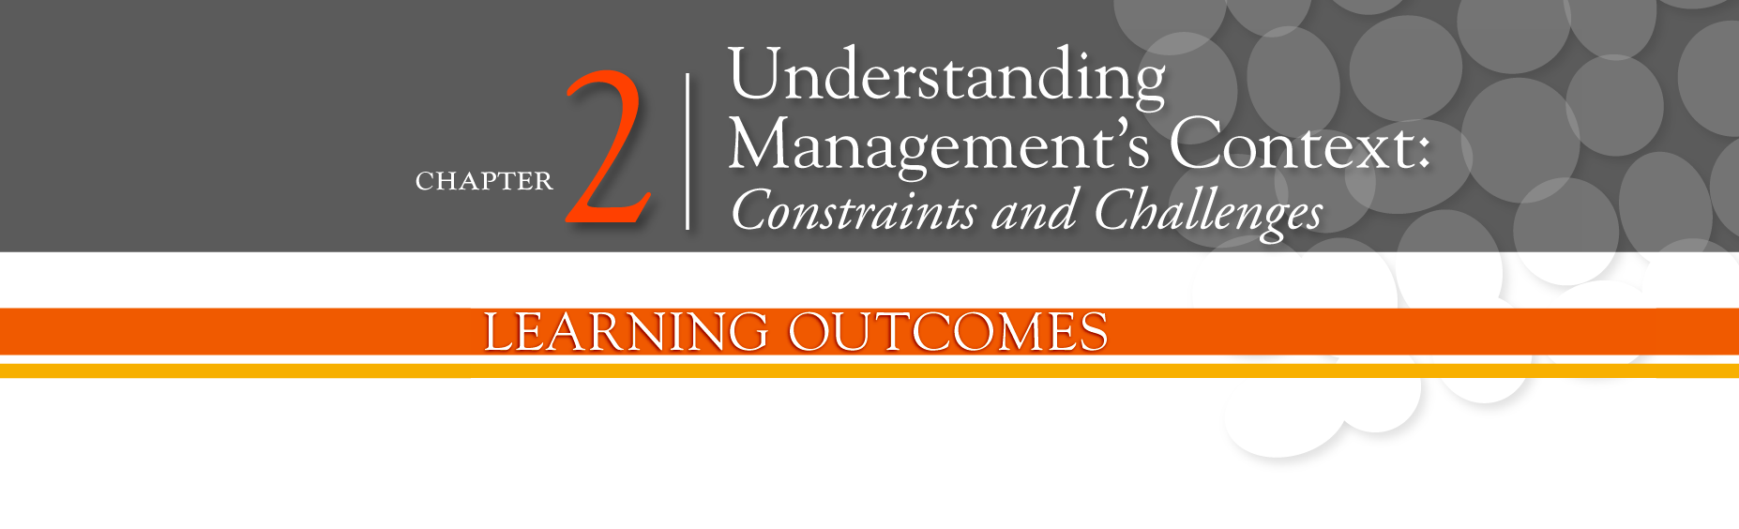
Contrast the actions of managers according to the omnipotent and symbolic views
Describe the constraints and challenges facing managers in today’s external environment
Discuss the characteristics and importance of organizational culture
Describe current issues in organizational culture

Slide 3
The Manager:
Omnipotent or Symbolic?
Omnipotent View of Management - the view that managers are directly responsible for an organization’s success or failure.
Symbolic view of Management - the view that much of an organization’s success or failure is due to external forces outside managers’ control.

Slide 4

Exhibit 2-1: Constraints on Managerial Discretion

Slide 5
The External Environment:
Constraints and Challenges
External Environment - those factors and forces outside the organization that affect its performance.
Components of the External Environment
  Specific environment: External forces that have a direct and immediate impact on the organization
  General environment: Broad economic, socio-cultural, political/legal, demographic, technological, and global conditions that may affect the organization

Slide 6
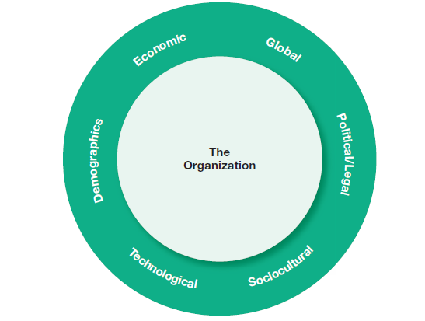
Exhibit 2-2: Components of External Environment

Slide 7
Environmental Uncertainty and Complexity
Environmental Uncertainty - the degree of change and complexity in an organization’s environment.
Environmental Complexity - the number of components in an organization’s environment and the extent of the organization’s knowledge about those components.

Slide 8
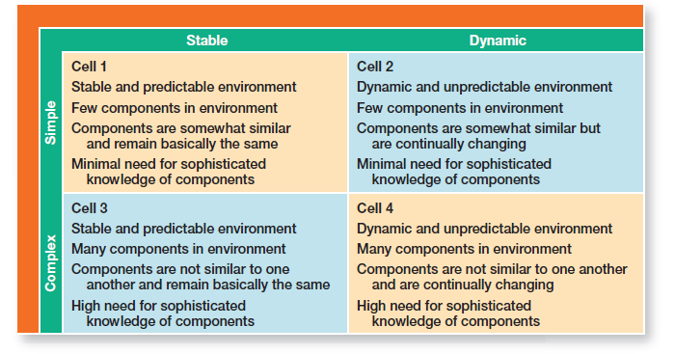
Exhibit 2-3: Environmental Uncertainty Matrix

Slide 9
Who Are Stakeholders?
Stakeholders - any constituencies in the organization’s environment that are affected by an organization’s decisions and actions.

Slide 10
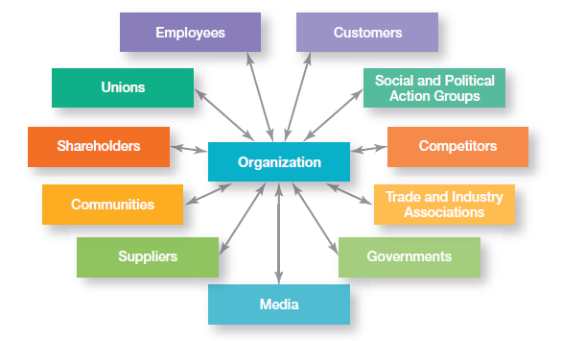
Exhibit 2-4: Organizational Stakeholders

Slide 11
Managing Stakeholder Relationships
Identify the organization’s external stakeholders.
Determine the particular interests and concerns of external stakeholders.
Decide how critical each external stakeholder is to the organization.
Determine how to manage each individual external stakeholder relationship.

Slide 12
Organizational Culture:
Constraints and Challenges
  Each of us…. unique personality- traits and characteristics
  influences the way we act and interact with others
  e.g warm, open, relaxed, shy, or aggressive, we’re describing personality traits
  Org., too, has a personality, which we call its culture.
  Influences the way employees act and interact with others

Slide 13
What Is Organizational Culture?
e.g. JetBlue
e.g. W.L. Gore and Associates
Organizational Culture - The shared values, principles, traditions, and ways of doing things that influence the way organizational members act. In most organizations, these shared values and practices have evolved over time and determine to a large extent, how “things are done around here.”

Slide 14
continued…
Definition of culture implies three things:
  Culture is a perception: something that cannot be touched or seen, but employees perceive on the basis of what they experience within the organization.
  Culture is descriptive: concerned with how members perceive the culture and describe it, not with whether they like it.
  Culture is shared: though individuals may have different backgrounds and work at different levels they tend to describe in similar terms.

Slide 15
Dimensions of Organizational Culture
Research suggested seven dimensions to describe org. culture
range from low to high, means it’s not very typical of the culture (low) or its very typical of the culture (high)
gives composite picture of the org. culture
in many org., one cultural dimension often is emphasized more than the others and essentially shapes the org. personality and the way org. members work

Slide 16
continued….
e.g. Sony Corporation: focuses on innovation (innovation & risk taking). Co. “lives & breathes” new product development and employees work behaviors support that goal.
Southwest Airlines: made its employees a central part of its culture (people orientation)
Exhibit 2.6 how dimensions can create significantly different cultures

Slide 17
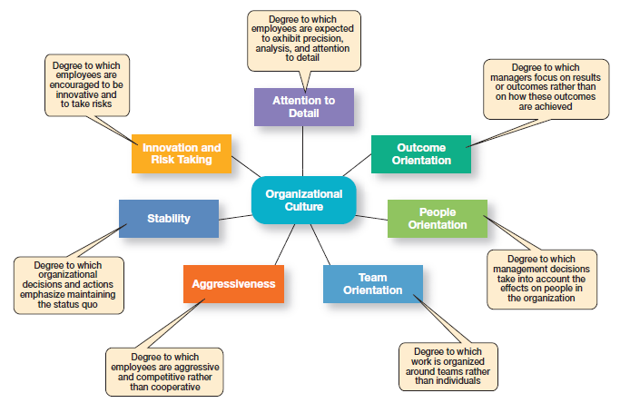
Exhibit 2-5: Dimensions of Organizational Culture

Slide 18
Strong Cultures - Organizational cultures in which key values are intensely held and widely shared.

Slide 19
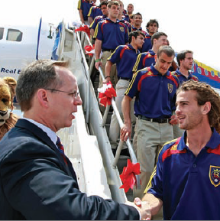
Where Does Culture Come From?
Organization founder
Vision and mission
Past practices
Top management behavior
Socialization - The process that helps employees adapt to the organization’s culture.

Slide 20
How Do Employees Learn Culture?
Stories - Narratives of significant events or people, e.g. organization founders, rule breaking, reaction to past mistakes etc.
Rituals - Sequences of activities that express and reinforce the important values and goals of the organization

Slide 21
How Employees Learn Culture (cont.)
Material Artifacts and Symbols - Convey the kinds of behavior that are expected, e.g. risk taking, participation, authority, etc.
Language - Acts as a common denominator that bonds members

Slide 22
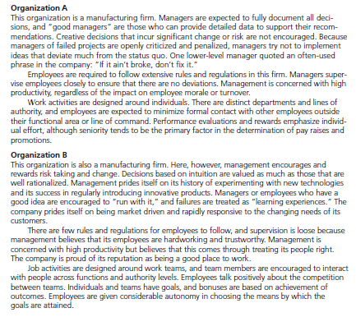
Exhibit 2-6: Contrasting Organizational Cultures

Slide 23
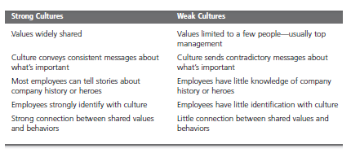
Exhibit 2-7: Strong vs. Weak Cultures

Slide 24
Benefits of a Strong Culture
Creates a stronger employee commitment to the organization
Aids in the recruitment and socialization of new employees
Fosters higher organizational performance by instilling and promoting employee initiative

Slide 25
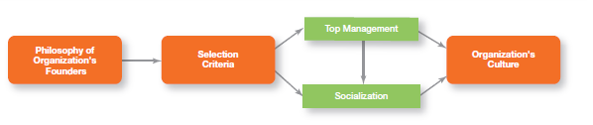
Exhibit 2-8: Establishing and Maintaining Culture

Slide 26
How Does Culture Affect Managers?
Cultural Constraints on Managers
  Whatever managerial actions the organization recognizes as proper or improper on its behalf
  Whatever organizational activities the organization values and encourages
  The overall strength or weakness of the organizational culture

Slide 27
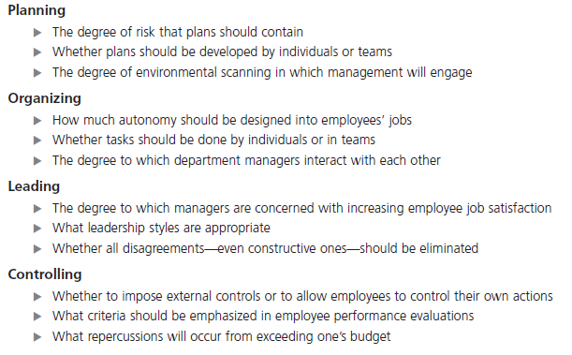
Exhibit 2-9: Managerial Decisions
Affected by Culture

Slide 28
How Do You Create a Customer
Responsive Culture?
Hire the right type of employees (those with a strong interest in serving customers)
Have few rigid rules, procedures, and regulations
Use widespread empowerment of employees
Have good listening skills in relating to customers’ messages

Slide 29
How Do You Create a Customer Responsive Culture?
Provide role clarity to employees in order to reduce ambiguity and conflict and to increase job satisfaction
Have conscientious, caring employees willing to take initiative

Slide 30
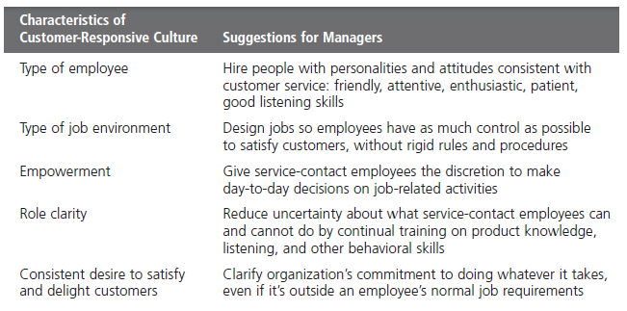
Exhibit 2-10: Creating a Customer
Responsive Culture

Slide 31
Spirituality and Culture
Workplace Spirituality - a culture where organizational values promote a sense of purpose through meaningful work that takes place in the context of community
Characteristics of a Spiritual Organization
  Strong sense of purpose
  Focus on individual development
  Trust and openness
  Employee empowerment
  Toleration of employees’ expression

Slide 32
Terms to Know
omnipotent view of management
symbolic view of management
organizational culture
strong cultures
socialization
workplace spirituality
external environment
specific environment
general environment
environmental uncertainty
environmental complexity
stakeholders

Slide 33
